Slide 1
Testing & Evaluation
Milestone 5 done by: Mehraeel Philip, Fatema Milad, Sama Gehad, Marwan Ahmed, Mo’men Mohie & Jana Mahdy

Slide 2
TESTING STRATEGY
01
Unit Testing
02
Integration Testing
03
System Testing
04
User Acceptance Testing
each module independently
modules working together
full pipeline (upload → analysis → report)
evaluated by directors/users

Slide 3
TEST PLAN (high level)
OBJECTIVES
Ensures the system:
Accurately detects gaze, emotion, voice, gestures, posture
Segments actions correctly
Produces meaningful performance reports
SCOPE
Includes:
Video uploading testing
Video dataset testing (Sample Videos)
ML model evaluation
UI usability

Slide 4
A. Functional Cases
A1. Video Input
TEST ID | TEST CASE | STEPS | EXPECTED RESULT
TC-01 | File upload | Choose file | Accepts browsing
TC-02 | Frame Capture | Run system | Frames processed continuously
TC-03 | Invalid file type | Wrong fie input | Error handled gracefully
TC-04 | File ready to be processed | Start analysis | Load report

Slide 5
A. Functional Cases
A2. Emotion Detection
TEST ID | TEST CASE | EXPECTED RESULT
TC-05 | Happy face | "Happy" detected
TC-06 | Sad acting | "Sad" detected
TC-07 | Neutral | Neutral detected
TC-08 | Lighting change | Still detects correctly

Slide 6
A. Functional Cases
A3. Face and Eye Tracking
TEST ID | TEST CASE | EXPECTED RESULT
TC-09 | No face | No crash, no detection
TC-10 | Eye Tracking | Eye scoring and analysis
TC-11 | No voice | No crash, no detection
TC-12 | Multiple faces | Only one face tracked

Slide 7
A. Functional Cases
A4. Gesture Recognition
TEST ID | TEST CASE | EXPECTED RESULT
TC-13 | Known gesture | Correct classification
TC-14 | Unknown gesture | Rejected or low confidence
TC-15 | Speed variation | Still recognized
TC-16 | Noise input | No false positives

Slide 8
A. Functional Cases
A5. Action Segmentation
TEST ID | TEST CASE | EXPECTED RESULT
TC-17 | Multiple actions | All actions segmented
TC-18 | Overlapping actions | Correct boundaries
TC-19 | Speed variation | Still recognized
TC-20 | Missing frames | Robust handling, scoring

Slide 9
A6. Report Generation
TEST ID | TEST CASE | EXPECTED RESULT
TC-21 | Generate report | Output created
TC-22 | Printing report | Printed locally
TC-23 | Score display | Numeric scores shown
TC-24 | Performance classification | Good, Moderate or Bad shown
TC-25 | Visualization | Widgets render
TC-26 | New analysis restart | Button accessible
TC-27 | Variables Classification | Independent variable scoring
TC-28 | Recommendations | Improvement advices

Slide 10
B. Non-Functional Cases
B1. Performance Testing
TEST ID | TEST CASE | EXPECTED RESULT
TC-29 | FPS (real-time) | ≥ 15 FPS
TC-30 | Processing delay | < 200 ms
TC-31 | CPU usage | < 80%
TC-32 | Memory usage | Stable

Slide 11
B. Non-Functional Cases
B2. Usability Testing
TEST ID | TEST CASE | EXPECTED RESULT
TC-33 | First-time user | Can run without help
TC-34 | UI clarity | Buttons understandable
TC-35 | Report readability | Easy to interpret
TC-36 | Error messages | Clear

Slide 12
B. Non-Functional Cases
B3. Security Testing
TEST ID | TEST CASE | EXPECTED RESULT
TC-37 | Invalid file upload | Rejected
TC-38 | Large file | Handled safely
TC-39 | Data privacy | No external leaks
TC-40 | Path injection | Prevented

Slide 13
B. Non-Functional Cases
B4. Reliability Testing
TEST ID | TEST CASE | EXPECTED RESULT
TC-40 | Multiple runs | Stable
TC-41 | Restart system (Recovery) | Works again
TC-42 | Load testing | Expected user loads processed
TC-43 | Feature testing | Individual functions working
TC-44 | Endurance testing | Stable
TC-45 | Mean Time To Repair | < 1s

Slide 14
CONTENTS OF THIS TEMPLATE
You can delete this slide when you’re done editing the presentation
Fonts | To view this template correctly in PowerPoint, download and install the fonts we used
Used and alternative resources | An assortment of graphic resources that are suitable for use in this presentation
Thanks slide | You must keep it so that proper credits for our design are given
Colors | All the colors used in this presentation
Icons and infographic resources | These can be used in the template, and their size and color can be edited
Editable presentation theme | You can edit the master slides easily. For more info, click here

Slide 15
01
OUR TEACHING METHOD
You can enter a subtitle here if you need it

Slide 16
INTRODUCTION
Here you can give a brief description of the topic you want to talk about. For example, if you want to talk about Mercury, you could say that it’s the smallest planet in the entire Solar System

Slide 17
—SOMEONE FAMOUS
“This is a quote, words full of wisdom that someone important said and inspire anyone who reads them.”

Slide 18
OUR TEACHING METHOD
ACTIVITIES
Saturn is a gas giant and has several rings
GOALS
FEEDBACK
Jupiter is the biggest planet of them all
Mercury is the closest planet to the Sun

Slide 19

A PICTURE IS WORTH A THOUSAND WORDS

Slide 20
WHAT SETS US APART
VENUS
JUPITER
MARS
Venus has a beautiful name and is the second planet from the Sun
Jupiter is a gas giant and the biggest planet in the Solar System
Mars is full of iron oxide dust, which gives the planet its reddish cast

Slide 21
THE CURRICULUM
INTRODUCTION
Mercury is the closest planet to the Sun and the smallest one in System
2XXX | Jupiter is a big planet
2XXX | Earth is where all live
2XXX | Mars is a cold place
2XXX | Saturn has several rings
ADVANTAGES
75%
80%
95%
EARTH
VENUS
SATURN
FEATURES
55%
NEPTUNE
75%
MERCURY

Slide 22
OUR ACADEMIC AREAS
MERCURY
VENUS
JUPITER
MARS
SATURN
EARTH
Mercury is the closest planet to the Sun
Venus is the second planet from the Sun
Jupiter is the biggest planet of them all
Despite being red, Mars is a cold place
Saturn is a gas giant and has several rings
Earth is the only planet that harbors life

Slide 23
MISSION AND VISION
MISSION
VISION
Saturn is composed mostly of hydrogen and helium. It was named after the Roman god of wealth and agriculture
Venus has a beautiful name and is the second planet from the Sun. It’s terribly hot, even hotter than Mercury

Slide 24
OUR VALUES
SATURN
EARTH
JUPITER
VENUS
Saturn is a gas giant and has several rings
Earth is the only planet that harbors life
Jupiter is the biggest planet of them all
Venus is the second planet from the Sun

Slide 25
OUR SUCCESS
MERCURY
JUPITER
75%
90%
VENUS
SATURN
85%
95%
Mercury is the closest planet to the Sun
Jupiter is the biggest planet of them all
Venus is the second planet from the Sun
Saturn is a gas giant and has several rings

Slide 26

A PICTURE REINFORCES THE CONCEPT
Images reveal large amounts of data, so remember: use an image instead of a long text. Your audience will appreciate it

Slide 27
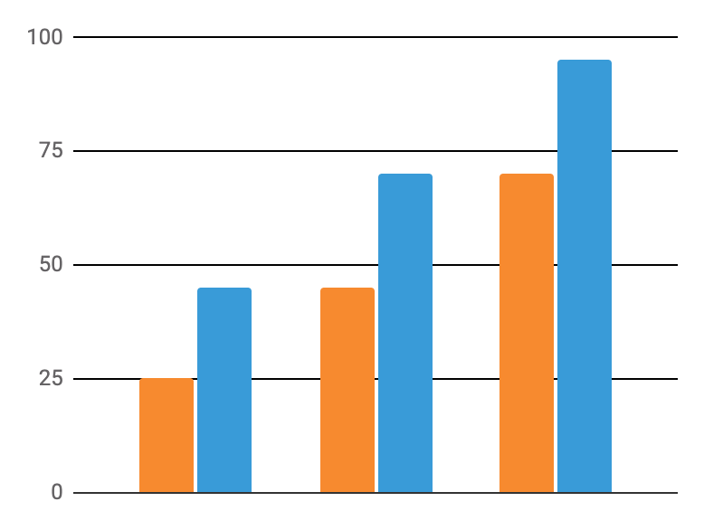
STATISTICS
VENUS
Venus is the second planet from the Sun
MARS
Despite being red, Mars is a cold place
Follow the link in the graph to modify its data and then paste the new one here. For more info, click here

Slide 28


OUR TEACHERS
JENNA DOE
TIMMY JIMMY
You can speak a bit about this person here
You can speak a bit about this person here

Slide 29
OUR GOALS
2XXX
SATURN
Saturn is a gas giant and has several rings
2XXX
VENUS
Venus is the second planet from the Sun
2XXX
JUPITER
Jupiter is the biggest planet of them all

Slide 30
150,000
Big numbers catch your audience’s attention

Slide 31
STUDENT PROGRESS
1ST TERM
3RD TERM
Saturn is a gas giant and has several rings
Earth is the only planet that harbors life
2ND TERM
4TH TERM
Jupiter is the biggest planet of them all
Venus is the second planet from the Sun

Slide 32
ENROLLMENT PROCESS
STEP 1
Saturn is a gas giant and has several rings
STEP 2
Venus is the second planet from the Sun
STEP 3
Jupiter is the biggest planet of them all

Slide 33
SPECIAL REMINDERS
Mercury is the closest planet to the Sun and the smallest one in the Solar System
Mars is a cold place. It's full of iron oxide dust, which gives the planet its reddish cast
Saturn is a gas giant and has several rings. It's composed mostly of hydrogen and helium
Earth is the third planet from the Sun and the only one that harbors life in the Solar System
Venus is terribly hot, even hotter than Mercury, and its atmosphere is extremely poisonous

Slide 34
ALTERNATIVE RESOURCES
Here’s an assortment of alternative resources whose style fits the one of this template:
VECTORS
Flat design data privacy invoice
Flat design data privacy instagram stories
Flat design data privacy letterhead

